Slide 1
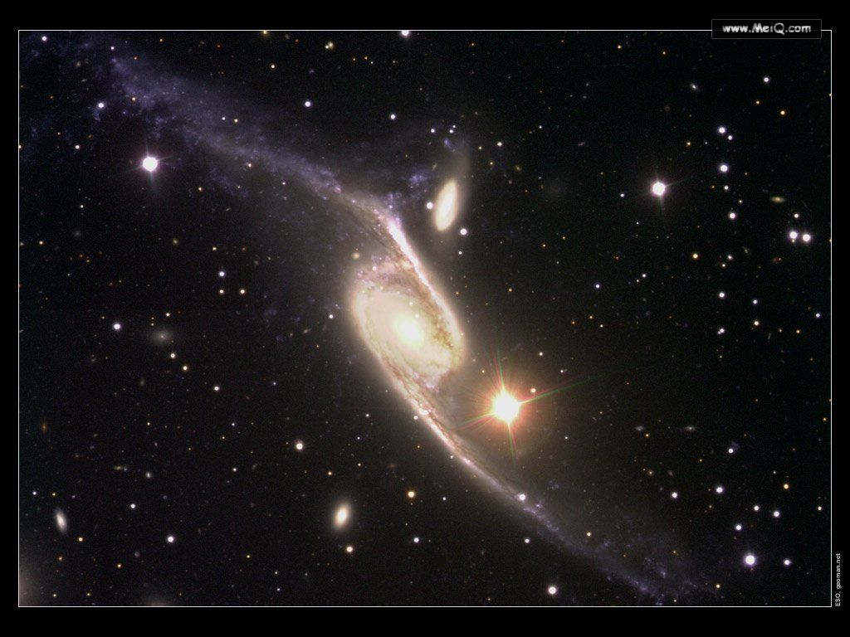

Module 5
The Conquest of the Universe

Slide 2

Grammar
Noun Clauses

Slide 3

名词性从句是由if, whether, that 和各种疑问词充当连接词所引导的从句，其功同名词一样。

Slide 4
一．主语从句
主语从句是在复合句中充当主语的从句，通常放在主句谓语动词之前或由形式主语it代替，而本身放在句子末尾。
1. it 作形式主语和it引导强调句的比较
it 作形式主语代替主语从句，主要是为了平衡句子结构，主语从句的连接词没有变化。而it引导的强调句则是对句子某一部分进行强调，无论强调的是什么成分，都可用连词that。被强调部分指人是也可用who/whom。例如：

Slide 5
It is a pity that you didn’t go to see the film.
It doesn’t interest me whether you succeed or not.
It is in the morning that the murder took place.
It is John that broke the window.

Slide 6
2. 用it 作形式主语的结构
(1) It is ＋名词＋从句
It is a fact that … 事实是…
It is an honor that …非常荣幸
It is common knowledge that …是常识
(2) it is ＋形容词＋从句
It is natural that… 很自然…
It is strange that… 奇怪的是…

Slide 7
(3) it is ＋不及物动词＋从句
It seems that… 似乎…
It happened that… 碰巧…
(4) it ＋过去分词＋从句
It is reported that… 据报道…
It has been proved that… 已证实…

Slide 8
3. 主语从句不可位于句首的五种情况
(1) if 引导的主语从句不可居于复合句句首。
(2) It is said , (reported) …结构中的主语从句不可提前。例如：
It is said that President Jingo will visit our school next week. (right)
That President Jiang will visit our school next week is said. (wrong)

Slide 9
3) It happens…, It occurs… 结构中的主语从句不可提前。
It occurred to him that he failed in the examination. (right)
That he failed in the examination occurred to him. (wrong)
(4) It doesn’t matter how/whether …结构中的主语从句不可提前。例如：
It doesn’t matter whether he is wrong or not. (right)
Whether he is wrong or not doesn’t matter. (wrong)

Slide 10
(5) 含主语从句的复合句是疑问句时，主语从句不可提前。例如：
Is it likely that it will rain in the evening? (right)
Is that will rain in the evening likely?
(wrong)

Slide 11
4. What 与that 在引导主语从句时的区别
What 引导主语从句时在句时在从句中充当句子成分，如主语\宾语\表语，而that 则不然。例如：
1) What you said yesterday is right.
2) That she is still alive is a consolation.

Slide 12
二．宾语从句
宾语从句就是在复合句中作宾语的名词性从句，通常放在主句谓语动词（及物动词）或介词之后。

Slide 13
1. 作动词的宾语
(1) 由that引导的宾语从句（that 通常可以省略），例如：
I heard that be joined the army.
(2) 由what, whether (if) 引导的宾语从句，例如：
1) She did not know what had happened.
2) I wonder whether you can change this note for me.
(3) 动词＋间接宾语＋宾语从句。例如：
She told me that she would accept my
invitation.

Slide 14
2. 作介词的宾语，
例如：
Our success depends upon how well we can co-operate with one another.
3. 作形容词的宾语
例如：
I am afraid (that) I’ve made a mistake.
That 引导的从句常跟在下列形容词后作宾语：

Slide 15
anxious, aware, certain, confident,
convinced, determined, glad, proud,
surprised, worried, sorry, thankful,
ashamed, disappointed, annoyed,
pleased, hurt, satisfied, content 等。
也可以将此类词后的that 从句的看作原因状语从句。

Slide 16
4. it 可以作为形式宾语
it 不仅可以作为形式主语，还可以作为形式宾语而真正的宾语that 从句则放在句尾，特别是在带复合宾语的句子中。 例如：We heard it that she would get married next mo-nth..

Slide 17
5. 后边不能直接跟that 从句的动词
这类动词有
allow, refuse, let, like, cause, force, admire, condemn, celebrate, dislike, love, help, take, forgive等。这类词后可以用不定式或动名词作宾语，但不可以用that引导的宾语从句。例如：
I admire their winning the match. (right)
I admire that they won the match. (wrong)

Slide 18
6. 不可用that从句作直接宾语的动词
有些动词不可用于“动词＋间接宾语＋that从句“结构中，常见的有
envy, order, accuse, refuse, impress, forgive, blame, denounce, advise, congratulate等。例如：
He impressed the manager as an honest man. (right)
He impressed the manager that he was an honest man. (wrong)

Slide 19
7. 否定的转移 。
若主句谓语动词为
think, consider, suppose, believe, expect, fancy, guess, imagine等，其后的宾语从句若含有否定义，一般要把否定词转移到主句谓语上，从句谓语用肯定式。 例如：
I don’t think this dress fits you well.（我认为这件 衣服不适合你穿。）

Slide 20
三．表语从句
表语从句在复合句中作表语的名词性从句，放在系动词之后，一般结构是“主语＋连系动词＋表语从句”。可以接表语从句的连系动词有be, look, remain, seem等。引导表语从句的that常可省略。

Slide 21
另外，常用的还有the reason is that… 和It is because 等结构。例如：
1) The question is whether we can make good preparation in such a short time.
2) This is why we can’t get the support of the people.
3) But the fact remains that we are behind the other classes.
4) The reason he is late for school is that he missed the early bus.

Slide 22
四．同位语从句
同位语从句就是在复合句中作名词的同位语的名词性从句。
1. 同位语从句的功能
同位语从句对于名词进一步解释，说明名词的具体内容，一般由that引导，例如：

Slide 23
1) The king’s decision that the prisoner would be set free surprised all the people. 2) The order that all the soldiers should stay still is given by the general.
2. 同位语在句子中的位置
同位语从句有时可以不紧跟在它所说明的名词后面，而是被别的词隔开。例如：
He got the news from Mary that the sportsmeeting was put off.

Slide 24
3. 同位语从句与定语从句的区别
(1) 定语从句中的that既代替先行词，同时以在从句中作某个成分（主语或宾语），而同位语从句中的that是连词，只起连接主句与从句的作用，不充当句中任何成分。
(2) 定语从句是形容词性的，其功能是修饰先行词，对先行词加以限定，描述定的性质或特征；同位语从句是名词性的，其功能是对名词进行补充说明。例如：

Slide 25
1) The news that he told me is that Tom would go abroad next year.（他告诉我的消息是汤姆明年将出国。）
（第一个that引导的从句是定语从句，that在从句中作宾语）
2)The news that Tom would go abroad is told by him.（汤姆将出国的消息是他讲的。）
（同位语从句，that在句中不作任何成分）

Slide 26
Activity
Grammar 1
1
a b d
（1） d
（2） c
（3） b
（4） f
（5） a
（6） e
2

Slide 27
(a) It can be the subject (1), object (3&5), predicative (2) or parity (4) .
(b) Yes. (3&5)
(c) In the objective clauses the world “that” can be left out.
3

Slide 28
4
（1）When the space race will end
（2）Apollo II had less power than a domestic PC
（3）whether people will walk on Mars in my lifetime
（4）that space travel is very expensive
（5）the right training to become an astronaut

Slide 29
Grammar 2
1
（1）if there is life on Mars
（2）the question people asked about Mars in the past
（3）what we know about Mars
（4）what awaited them
（5）that a day on Mars has an extra 37 minutes to allow the data-hungry robots to remember everything
（6）the answer is “no”

Slide 30
2
a) 1
b) 2
c) 6
d) 4
e) 5
f) 3

Slide 31
名词性从句与高考试题 : 主语从句
[考例]_______fashion differs from country to country may reflect the cultural differences from one aspect.(2002上海春季)
A. What B. That C. This D. Which
解析:这是含有一个主语从句的句子。因为主语从句是一个完整的句子,所以要填写that。这句话的意思是"国与国之间的时装差异可以从一个方面反映出其文化的差异"。答案为B。

Slide 32
[考例]_______ she couldn't understand was_______ fewer and fewer students showed interest in her lessons.( 2000上海)
A. What; why B. That; what
C. What; because D. Why; that
解析:答案为A。主语从句she couldn't understand缺少宾语,要用what引导。表语从句fewer and fewer students showed interest in her lessons是一个完整的句子,要用why引导,意思是"为什么越来越少的学生对她的课感兴趣。"

Slide 33
表语从句
[考例] - Are you still thinking about yesterday's game?
-Oh, that's_______ . (2003北京春)
A. what makes me feel excited
B. whatever I feel excited about
C. how I feel about it
D. when I feel excited
解析:上文的关键词语"still thinking about yesterday's game"决定必然用表语从句what makes me feel excited ,表示比赛留下久久不能忘怀的印象,豪情激发,现在还在thinking;B项是泛泛而指,当然不行;C和D项内容与上下文问题无关。故答案为A.

Slide 34
[考例]-I drove to Zhuhai for the air show last week.
-Is that_______ you had a few days off?(NMET1999)
A. why B. when C. what D. where
解析:这是一个由why引导的表语从句,表示原因.这句话的意思是"这就是你离开的原因吗?"。故答案为A。

Slide 35
同位语从句
跟同位语从句的名词主要有:idea, news, promise, answer, belief, condition, doubt, fear, hope, problem, proof, question, reply, report, suggestion, thought, truth等。

Slide 36
[考例]Information has been put forward_______ more middle school graduates will be admitted into universities.( 2001上海)
A. while B. that C. when D. as
解析:that引导从句作information的同位语,解释information的具体内容.这句话的意思是"有消息说,有更多的中学毕业生将进入大学"。由于information与同位语从句被has been put forward分隔开来,增加了试题的难度。

Slide 37
宾语从句
连词that，whether，if；连接代词who，which，what以及其强调形式 whoever，whichever，whatever；连接副词 when，where，why，how

Slide 38
[考例]When you answer questions in a job interview, please remember the golden rule: Always give the monkey exactly_______ he wants .(2002上海春)
A. what B. which C. when D. that
解析:这是一个宾语从句,wants后面缺少宾语,故答案为A。

Slide 39
[考例]Mr. Hall understands that _______ maths has always been easy for him, it is not easy for the students. ( 2003安徽春)
A. unless B. since C. although D. when
解析:该题考查连词在宾语从句中的用法.观察题干Mr. Hall understands是主句, 其后有that引导的宾语从句,可将该句简化为: _______ maths has always been easy for him, it is not easy for the students.分析简化后的句子可知, maths has always been easy for him与it is not easy for the students之间含有转折关系,其他选项不合题干逻辑。故答案为C。

Slide 40

高考链接
1.____ matters most in learning English is enough practice. (2007 全国II)
A. What B. Why
C. Where D. Which

Slide 41
2. ______ he referred to in his article was unknown to the general reader. (2007 上海)
A. That B. What
C. Whether D. Where

Slide 42
3. The traditional view is ______ we sleep because our brain is “programmed” to make us do so. (2007 上海)
A. when B. why
C. whether D. that

Slide 43
4. Could I speak to--------- is in charge of International Sales ,please? (2007 山东)
A．anyone B．someone C．whoever D．no matter who

Slide 44
5. You can only be sure of_________ you have at present; you cannot be sure of something _____ you might get
in the future. (2007 安徽)
A. that; what B. what; /
C. which; that D. /; that

